Slide 1
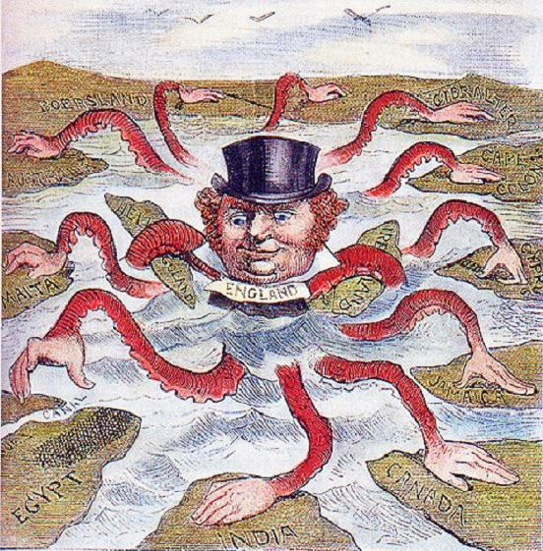
European Colonialism of Africa

Slide 2
What is colonialism?
The “taking over” of a weaker country by a stronger one; the use of the weaker country’s resources to strengthen and enrich the stronger country
WHICH IS JUST A FANCY WAY OF SAYING… one country has total control of another country/territory
In this case, we are talking about Europe (strong) taking over Africa (weak)

Slide 3
What was Africa like before Europe messed with it?
Divided amongst ethnic and linguistic groups
Europeans had little contact with interior Africans due to:
  Disease
  Difficulty traveling to the interior (rivers, deserts, other scary landforms)
  African military
Missionaries, explorers and humanitarians were the only humans to explore the interior of Africa

Slide 4
But then Europe started to feel the itch… and the scramble for Africa was on.

Slide 5
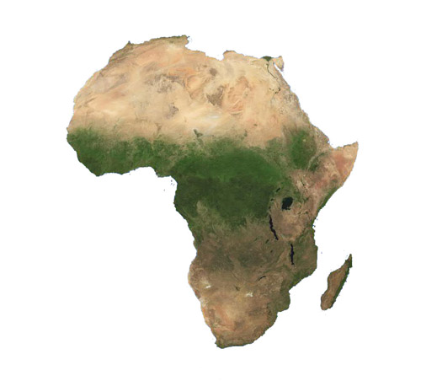
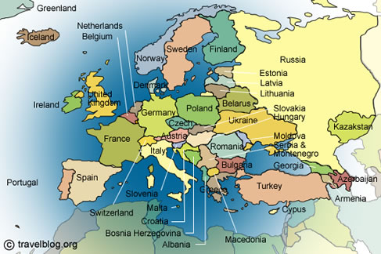
Why Africa?

Slide 6
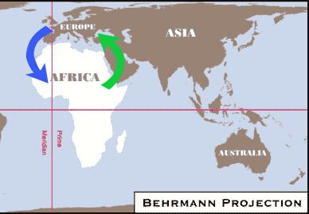
Location, location, location
Europe was present in Africa because of its proximity (closeness) to Africa as people traded all around the Mediterranean Sea.

Slide 7
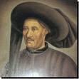

Who explored Africa?
Prince Henry of Portugal was the first European to really explore Africa (he sponsored the trips at least) as his ships made many trips along the western coast of Africa.
P.S. As a result of this, Portugal was the first European country to get slaves from Africa to use in the New World colonies.

Slide 8



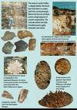


What were they looking for?
Other European countries explored and colonized Africa for the same reasons they colonized North and South America...they were looking for natural resources and wealth.

Slide 9
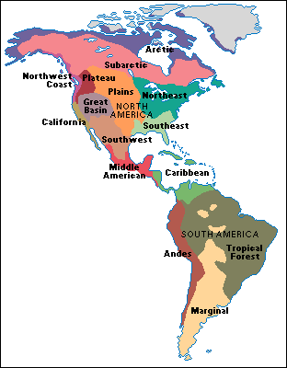
Why did the Europeans want to colonize or explore other countries?
They colonized N. & S. America because they were quickly running out of resources in Europe as a result of the Industrial Revolution.

Slide 10
But seriously, why Africa?
Africa was pretty much the only mostly uncolonized continent at the time, so the European countries moved in.
Problem was, they were constantly bumping into each other as they claimed land and resources, and of course, this increased tension between these countries and will be at least an indirect cause of WWI.

Slide 11
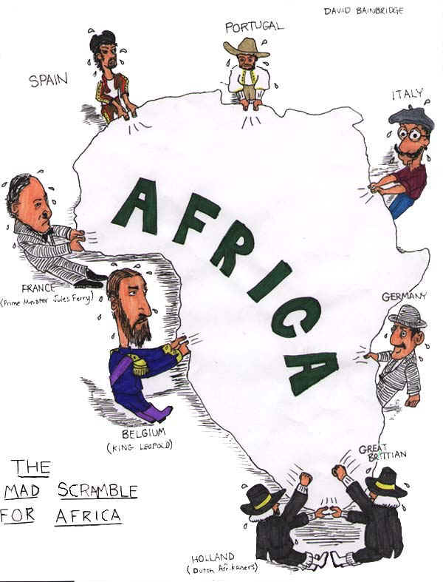

Slide 12
Trade in Human Beings
Once the American colonies were established, the demand for slaves increased dramatically.
Needed cheap labor (free) to work on colonial plantation systems, which produced expensive goods.
Where could they find this cheap labor?!

Slide 13
Yep, AFRICA.

Slide 14
Motives for Colonization
God, Glory, and Gold (The 3 G’s)

Slide 15
European Motivations to Colonize Africa
There were 5 basic motivations driving Europeans to colonize Africa
  Economic motivations
  Political motivations
  Military motivations
  Social motivations
  Religions motivations

Slide 16


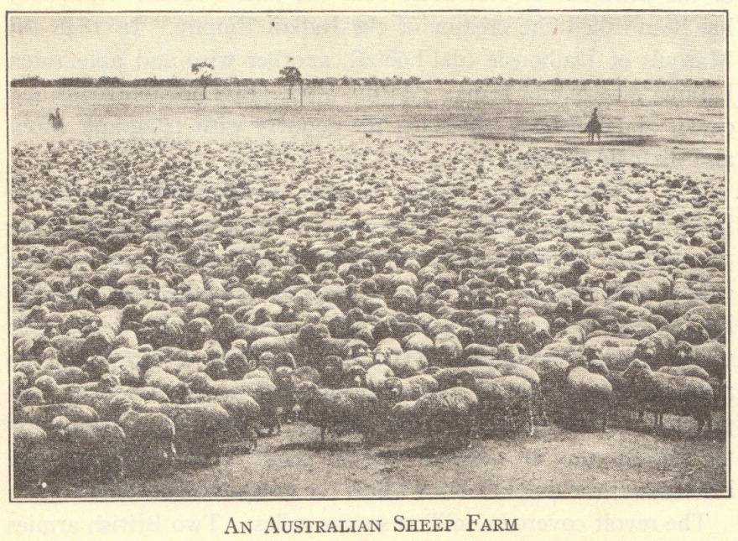


ECONOMIC MOTIVES
Sources of raw materials
  Egypt – cotton
  Malaya – rubber and tin
  Middle East – oil
There was a lot of $$ to be made off of Africa! And plenty of free labor to help make that money for Europe.
Notes:
Possible anecdote: Many foreign countries had to be coerced to purchase European goods. Railroads were built throughout Europeans’ colonial possessions and in areas where industrialized nations held economic and political influuence.

Slide 17
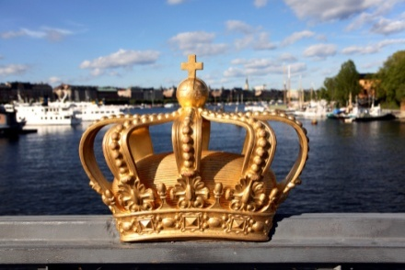
POLITICAL MOTIVES
Nationalism – national pride “we’re the best country ever!”
“The sun never sets on the British empire.”
Large empires increased national pride
Notes:
Possible anecdote: The legacy of empires is reflected in languages spoken around the world today, particularly English.

Slide 18

MILITARY MOTIVES
Could put military bases in Africa.
Manpower
  Recruit/force Africans to fight for their countries
Notes:
Possible anecdote: Compare the use of native troops within the British and French empires with the use of “barbarian” troops within the Roman empire, with the idea that imperial powers historically have never had enough of their own troops to maintain their empires.

Slide 19

SOCIAL MOTIVES
“White Man’s Burden”
  Rudyard Kipling’s poetry and prose
  Whites morally obligated to bring the “blessings of civilization” to “backward” peoples”
Notes:
Possible anecdote: Did imperial powers bestow any positive benefits? Did these benefits outweigh the costs of colonization?

Slide 20

RELIGIOUS MOTIVES
Conversion to Christianity
End-of-the-century crusading spirit
Missionaries in Africa, Asia, Hawaii, etc.
†
Notes:
Possible anecdote: In what ways did well-intentioned missionaries become cultural imperialists?

Slide 21
JUSTIFICATIONS
Europeans told themselves/the rest of the world that what they were doing was OK because of:
  Social Darwinism
    Interpreted Darwin’s evolutionary theory in terms of powerful nations
    “Only the strong survive”
  Powerful nations able to develop areas and resources being “wasted” by native peoples
  Racism
    Increased feelings of white superiority
    Eugenics developed as a branch of science
Notes:
Possible anecdote: Racism and eugenics developed and/or increased simultaneously to justify the dominance of imperial powers, both among the Japanese and Europeans.

Slide 22
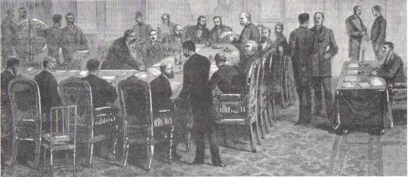
Competition for Africa: The Berlin Conference
Each European nation wanted the biggest and richest colonies
To avoid wars over territories, US and European leaders met in Berlin in 1884. They decided how to divide Africa – no Africans consulted.
Going into the meeting, only 10% of Africa was in Europe’s hands. Europeans owned most of Africa by end of conference.

Slide 23
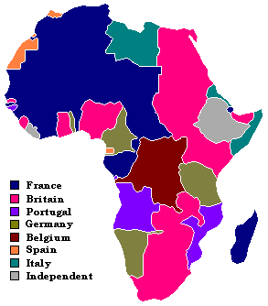
European Colonization of Africa

Slide 24
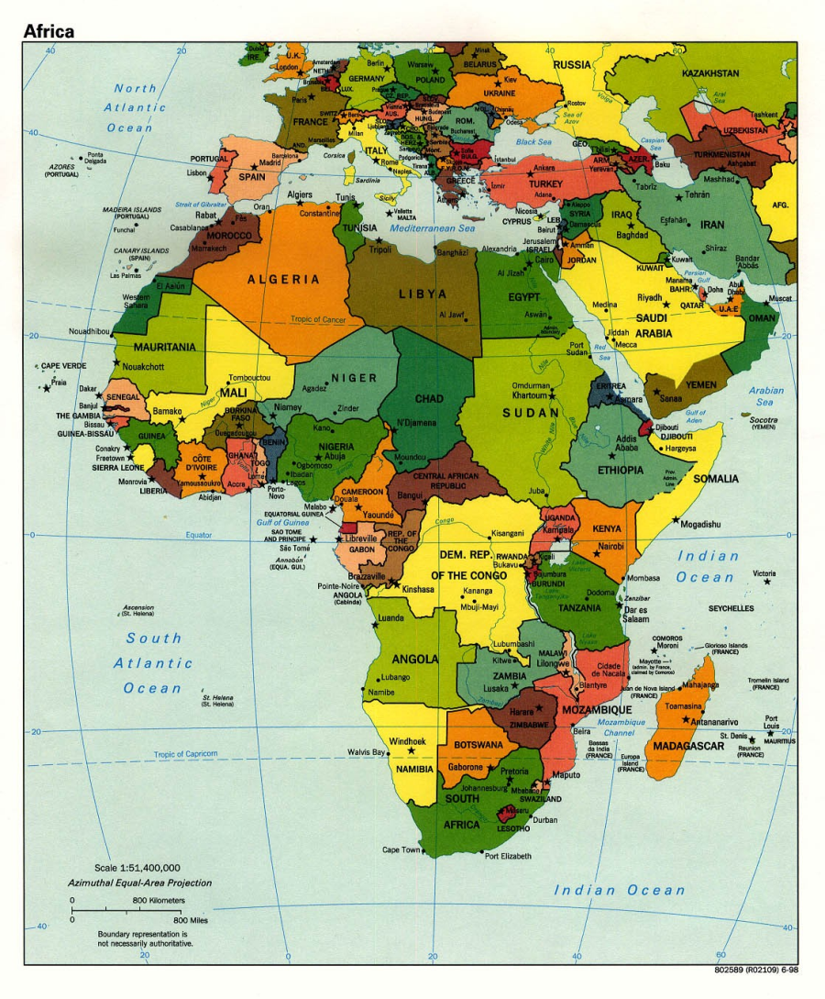
Impact of Colonial Rule
Africans had no control over their own countries.
Wars, riots, protest were common
Starvation and disease occurred
Africans forced into labor
New borders were drawn separating families and tribes
These effects lasted long after colonialism ended, some effects are still being felt today:
  Genocide in Darfur
  Speaking of English, French etc in African countries instead of traditional, native languages

