Slide 1
WORLD WAR II:
The Road to War
Directions: Complete your graphic organizer by writing down all GREEN information as right-side entry #28.

Slide 2
Main Ideas from Today
Underlying Causes of the War
Direct Cause of WWII
Main alliances
Reasons for American Neutrality
Reason for American entrance into War

Slide 3
Underlying Causes
Treaty of Versailles
Nationalism
Worldwide depression
Dictatorships – Hitler & Mussolini
Policy of appeasement
American isolationism

Slide 4
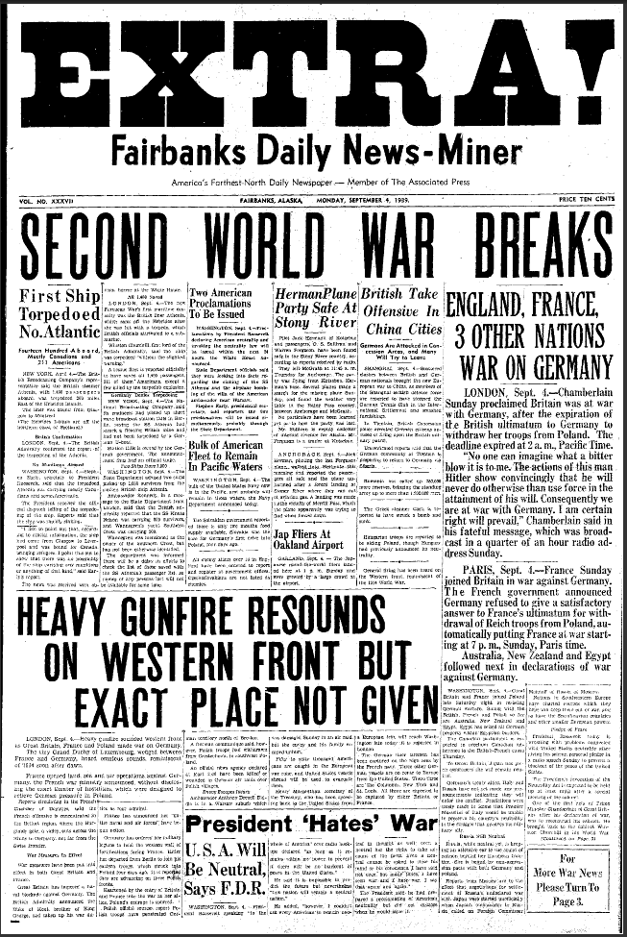
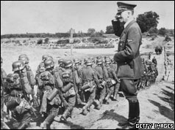
Direct Cause of WWII
Germany invading Poland on September 1, 1939

Slide 5
Alliances of WWII
AXIS POWERS
Germany
Italy
Japan
ALLIED POWERS
Great Britain
France
Soviet Union (after German attack on 6/22/41)
United States
More than 50 other countries

Slide 6
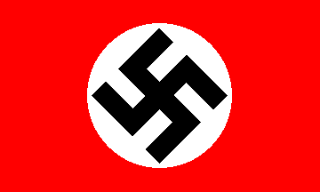

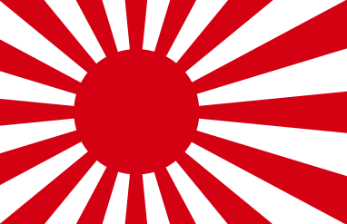
Actions by Axis Powers
In the years leading up to World War II, Germany, Italy, and Japan all took ambitious risks to try to improve their country’s power.

Slide 7
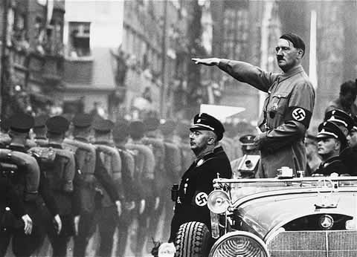
Hitler and Nazi Germany
Rise to power result of weakness of previous government (Hitler becomes Chancellor in 1933)
Charismatic speaker, preached German nationalism, and denounced the Treaty of Versailles
Blamed Jews for all of Germany’s problems
Promised the return of German pride

Slide 8
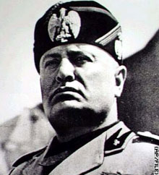
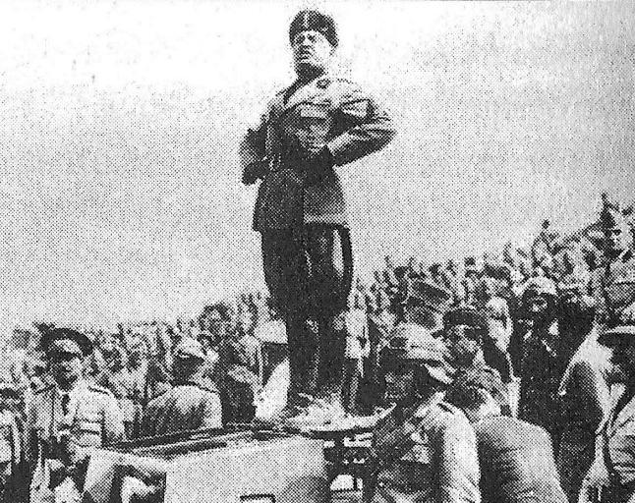
Benito Mussolini in Italy
Fascist leader who took control of Italy in 1922
Wanted to create another Roman Empire
Invaded Ethiopia in 1935
Promoted extreme nationalism in Italy

Slide 9
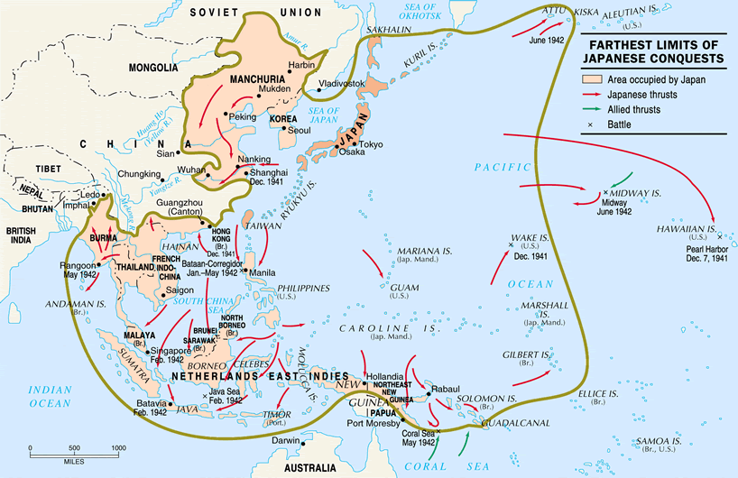
Japanese Expansion
Sought total control of the Pacific (resources)
1931 – military occupation of Manchuria
1936 – Japan signs pact with Germany & Italy

Slide 10
American Neutrality
In the United States, most suffering from Great Depression
Americans wanted to remain neutral and keep all resources to help get out of Depression
1935 – First Neutrality Act (no sale of arms or any assistance to a warring nation)
1937 – Arms sales only on a “cash and carry” basis (no way to track who America was supporting)
President FDR warned of impending problems in Europe

Slide 11
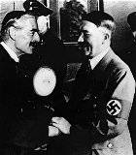
Policy of Appeasement
1938 – Hitler invades Austria, Sudetenland on Czech border
Munich Conference (1938): Chamberlain allows Hitler to keep the territory he has taken over (appeasement)
Chamberlain: “Peace in our time”
British rearmament to prepare in case of crisis
Adolf Hitler greeting British Prime Minister Neville Chamberlain upon his arrival in Munich in 1938.

Slide 12
War Erupts in Europe!!!
March 1939: Hitler breaks Munich agreement and invades rest of Czechoslovakia
Hitler signs nonaggression pact with USSR (August 1939)
September 1, 1939 – Hitler invades Poland using “blitzkrieg” attack
Britain and France declare war on Germany

Slide 13
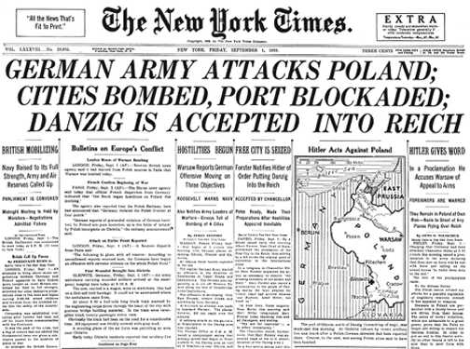

Slide 14
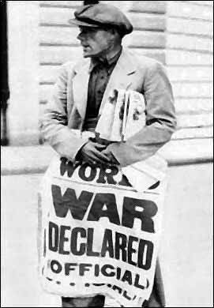
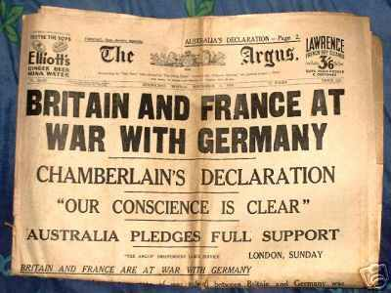

Slide 15
Hitler Marches Through Western Europe: 1939-1941
April 1940 – Hitler seizes Norway, Denmark
May – Netherlands, Belgium, Luxembourg
By June, Hitler controls France, turns attention to Britain
Fall 1940: Battle of Britain
London was heavily bombed but Churchill remained defiant (refused to surrender)
From 1939-1941, Hitler and German army took control of almost all of Europe
Hitler’s goal was to create “Fortress Germany”

Slide 16
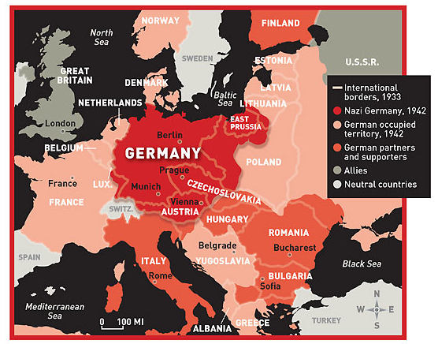

Slide 17
Can the U.S. remain neutral?
Lend-Lease Act (1941): allowed the U.S. to lend or lease supplies to Allied countries
U.S. wanted to ensure that its international trade would continue
Japan wanted to extend influence in the Pacific
July 1940 – U.S. trade embargo on raw materials to Japan
1941 – Lend-Lease aid to China

Slide 18
America Enters the War
Japanese wanted retaliation for trade embargo
Japanese attack Pearl Harbor (naval base on Oahu, Hawaii) on Sunday, December 7, 1941
Two waves of attack in early morning
2,400 Americans killed
FDR “A date which will live in infamy”
December 8, 1941 – Congress declares war against Japan
Germany and Italy then declare war on U.S.

Slide 19
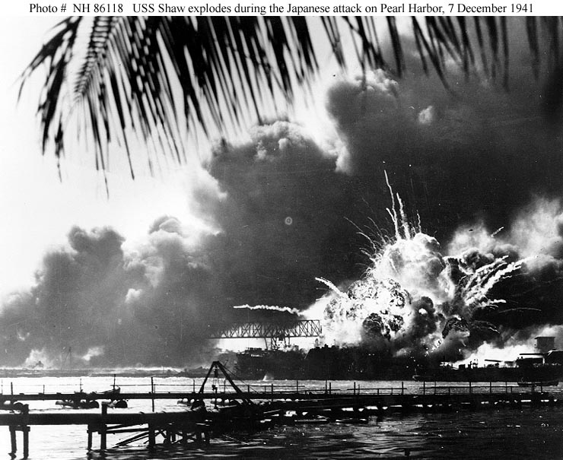

Slide 20
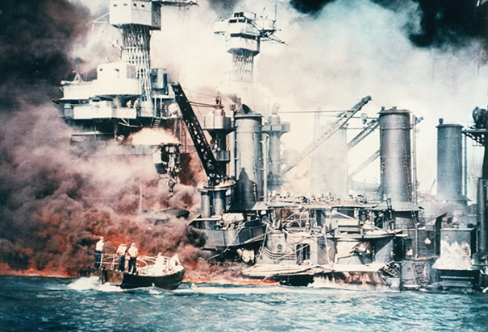
Battleships Burning at Pearl Harbor: December 7, 1941 the Japanese military launched a surprise attack on the US Naval base at Pearl Harbor. The attack sank or damaged over 14 naval vessels and killed over 2,300 U.S. Military personel. (Photo Credit: Corbis )

Slide 21
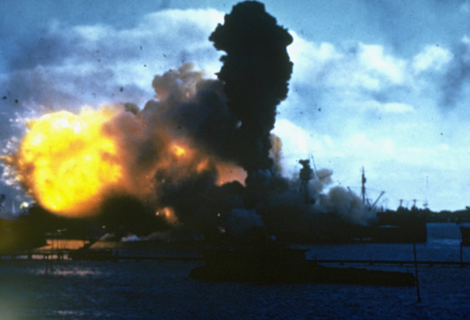
USS Arizona Burning at Pearl Harbor: The USS Arizona burns after being hit by a Japanese bomb in Pearl Harbor, December 7, 1941. (Photo Credit: Corbis )

Slide 22
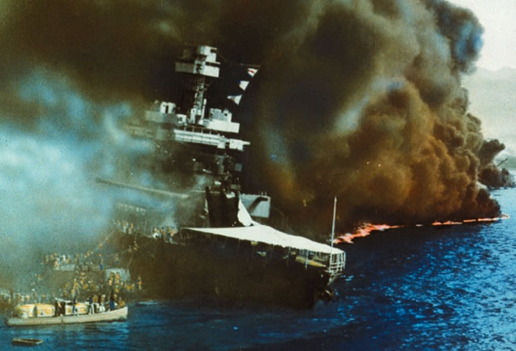
Pearl Harbor Bombing: Black smoke pouring from USS California on fire in Pearl Harbor after the surprise attack by the Japanese. (Photo Credit: Getty Images )

Slide 23
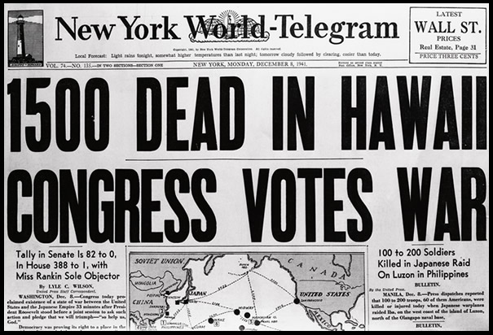

Slide 24
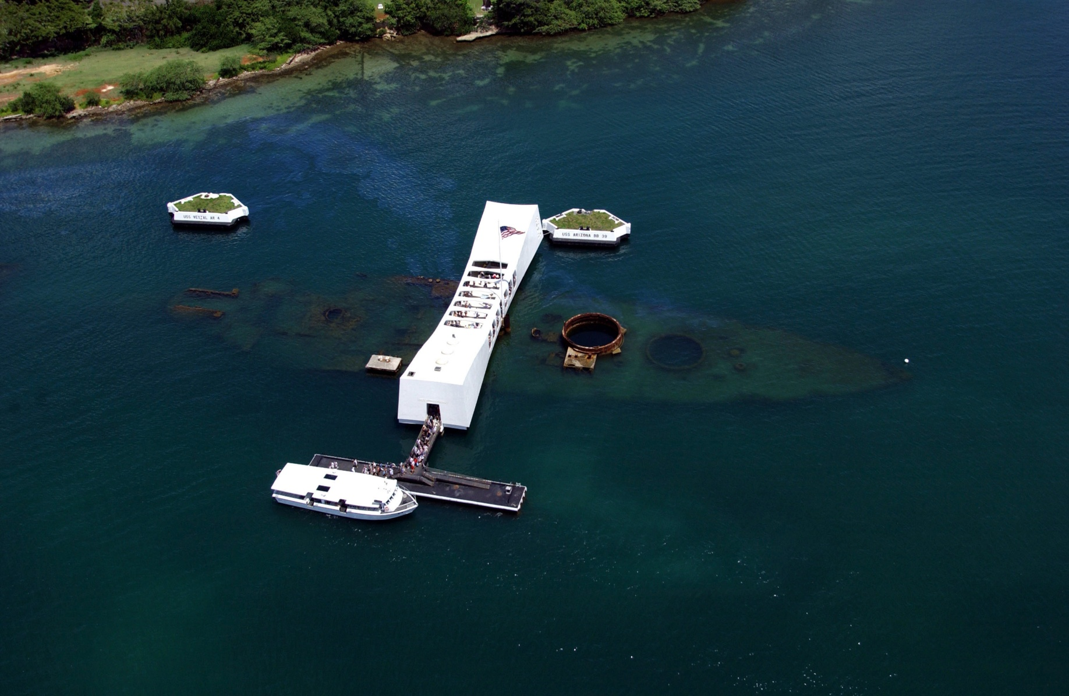
Pearl Harbor Today

Slide 25
